Slide 1

DriverPass System Analysis
Aceley Agustin
Notes:
[No speaker notes required for this slide.]

Slide 2

System Requirements
Functional Requirements
Login verification system
Scheduling notifications for appointments and cancellations
Non-Functional Requirements
Security
Platform Constraints
Notes:
The system has a few functional requirements, one of them is the ability to be able to login to the system and be verified, another is be able to get a notification for any changes or acceptance of scheduling.
Non-functional requirements are security for example, we can have notification for the users when their account is being brute forced and that their account has been locked in failed logins. As for the platform constraints, users will need to have a mobile or computer that has access to the internet, the system also needs a database to store data in our case the cloud.

Slide 3
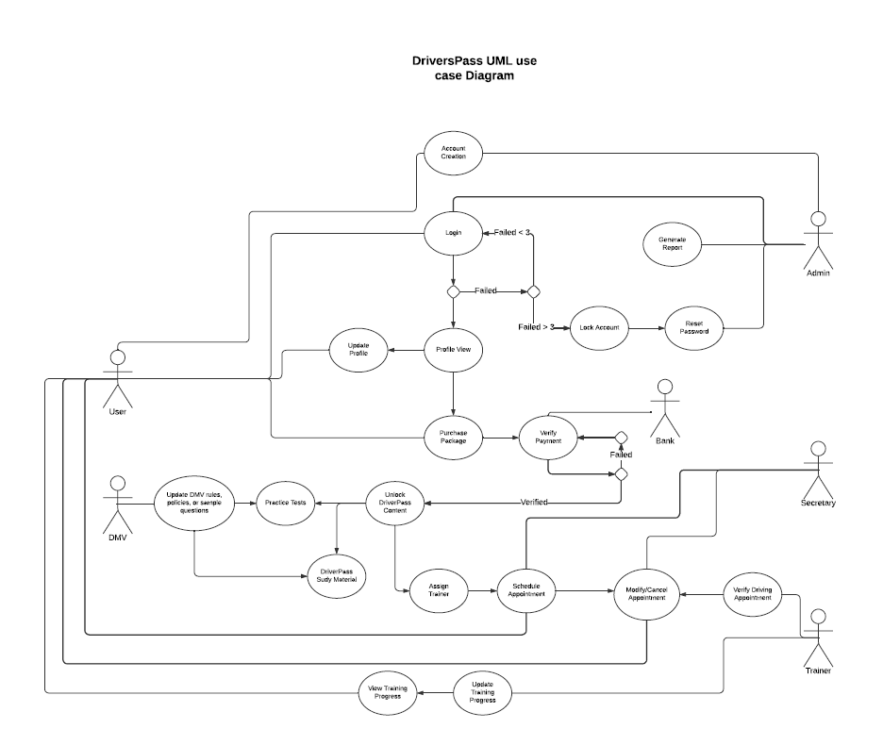
Use Case Diagram
Notes:
The diagram shows six entities to operate, the User/Customer, the Owner/Admin, Secretary, Trainer, Bank, and the DMV. These entities all work together to provide what the system creates. Users will create accounts and be able to use those to login to then be able to purchase a training package, when the package has been selected, they go through the payment system where the bank will verify the purchase and once the purchases is verified the customer will have the contents of the package unlocked. The package unlock will have the opportunity for the customer to have practice tests, guides (DMV provided), and to schedule driving training. The driving training schedule will then be verified with the secretary, and if modifications and cancellations again go through the secretary before going to the trainer for the training, and a record will be created to be viewable by the customer after training.

Slide 4
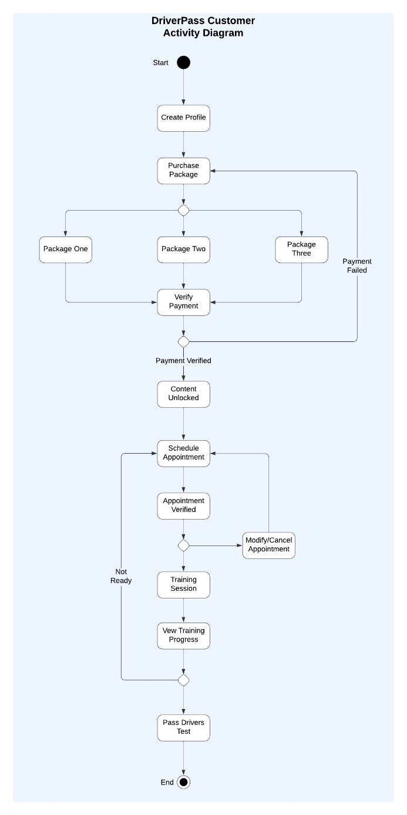
Activity Diagram
Notes:
The diagram above shows how a customer goes through the training. The DriverPass system is built with customers in mind, hence the design shown above. As we go down the diagram, you can see that once the customer creates an account and profile, they can then purchase a package which they are given three choices. Then payment must be verified if rejected they must go through the process of purchasing a package again, if accepted they unlock the contents of the package. They can then schedule an appointment, which then gets verified and if any changes or cancelations are needed, they go back and make another appointment. Finally, once training is happening the trainer will take notes and help the customer till, they pass the driver's test.

Slide 5
Security
User authentication via login
Can be expanded for 2FA in the future
Limit of 3 tries per login
Cloud based server and security
Secure website protocols will be adhered to
Notes:
To ensure security is covered for the customer and the employees, users will have to create accounts, and the data will be stored in the cloud or online. Security protocols will also be placed and managed online, and any intrusions or possible attacks should notify the owner and the system administrators. Since the system will be on a website, we will use certain web-based protocols to ensure that the website is secured, for both mobile and computer.

Slide 6
System Limitations
Online based customer service
Internet connectivity
Online based system manager
Cloud database/server failures
Notes:
Limitations of the design include mostly online connectivity; customers must have internet connection to access any information. The system also makes it so that the system is ran online, hence customer service is either via call or emails, instead of in person help, as well as system managers for more serious system failures. Since we have cloud-based storage and security if the system loses connection to the cloud, we are unable to access data.

